Slide 1
Intro to Neural Nets
Attention & Transformers

Slide 2

Today’s Agenda
Attention Mechanism in RNNs for Translation (2014)
Sequence to sequence models with attention in translation tasks.
More General, Approach (No RNNs Required)
We can hard-code a measure of semantic similarity between a focal token, and all other tokens in the sequence
QKV Framework & Multi-head Attention
We can incorporate trainable weights around the attention mechanism.

Slide 3
TF-IDF is “Static Attention”
Not all phrases are of equal importance…
E.g., David less important than Beckham
If a term occurs all the time, observing its presence is less informative
Inverse-document frequency (IDF) helps address this.
Term ‘weighting’ is then calculated as Term Frequency (TF) x IDF
n_{j}= # of docs containing the term, N = total # of docs
A term is deemed important if it has a high TF and/or a high IDF.
As TF goes up, the word is more common generally. As IDF goes up, it means very few documents contain this term.

Slide 4
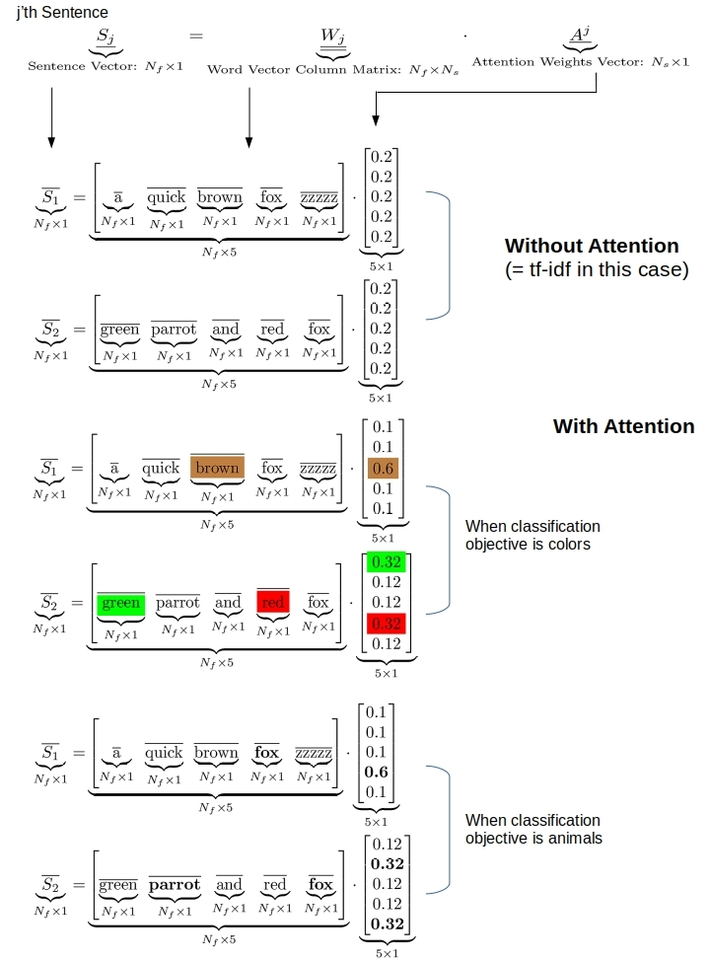
What Would Adaptive Weights Look Like?
Figure Out Weights Useful for Prediction
Rather than telling the network the weights, which is what TF-IDF effectively does, we provide the network a weight matrix to update!
This Yields Task-specific Token Weights
See some simple examples on the right.
Our network may learn that certain tokens are more important for predicting a given label.

Slide 5
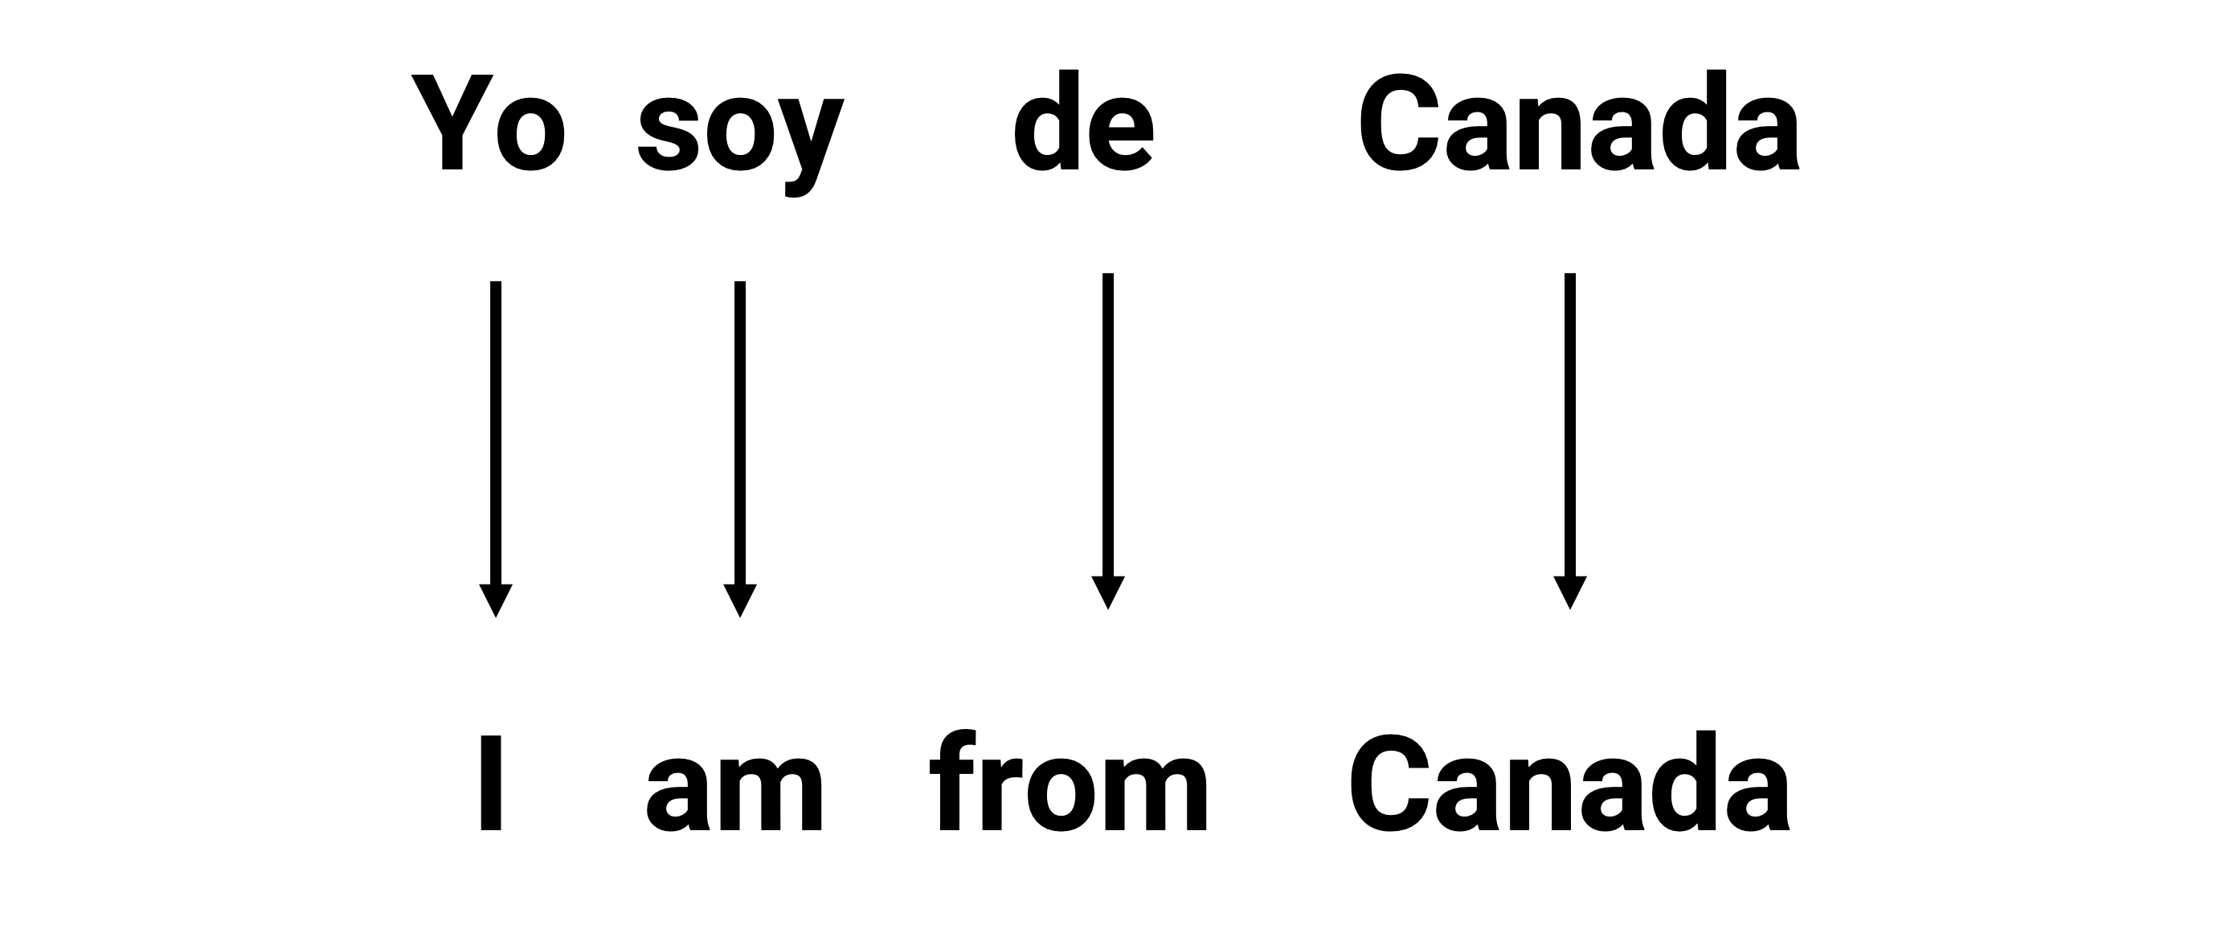
Where Attention Came From: Sequence-to-Sequence Models

Slide 6
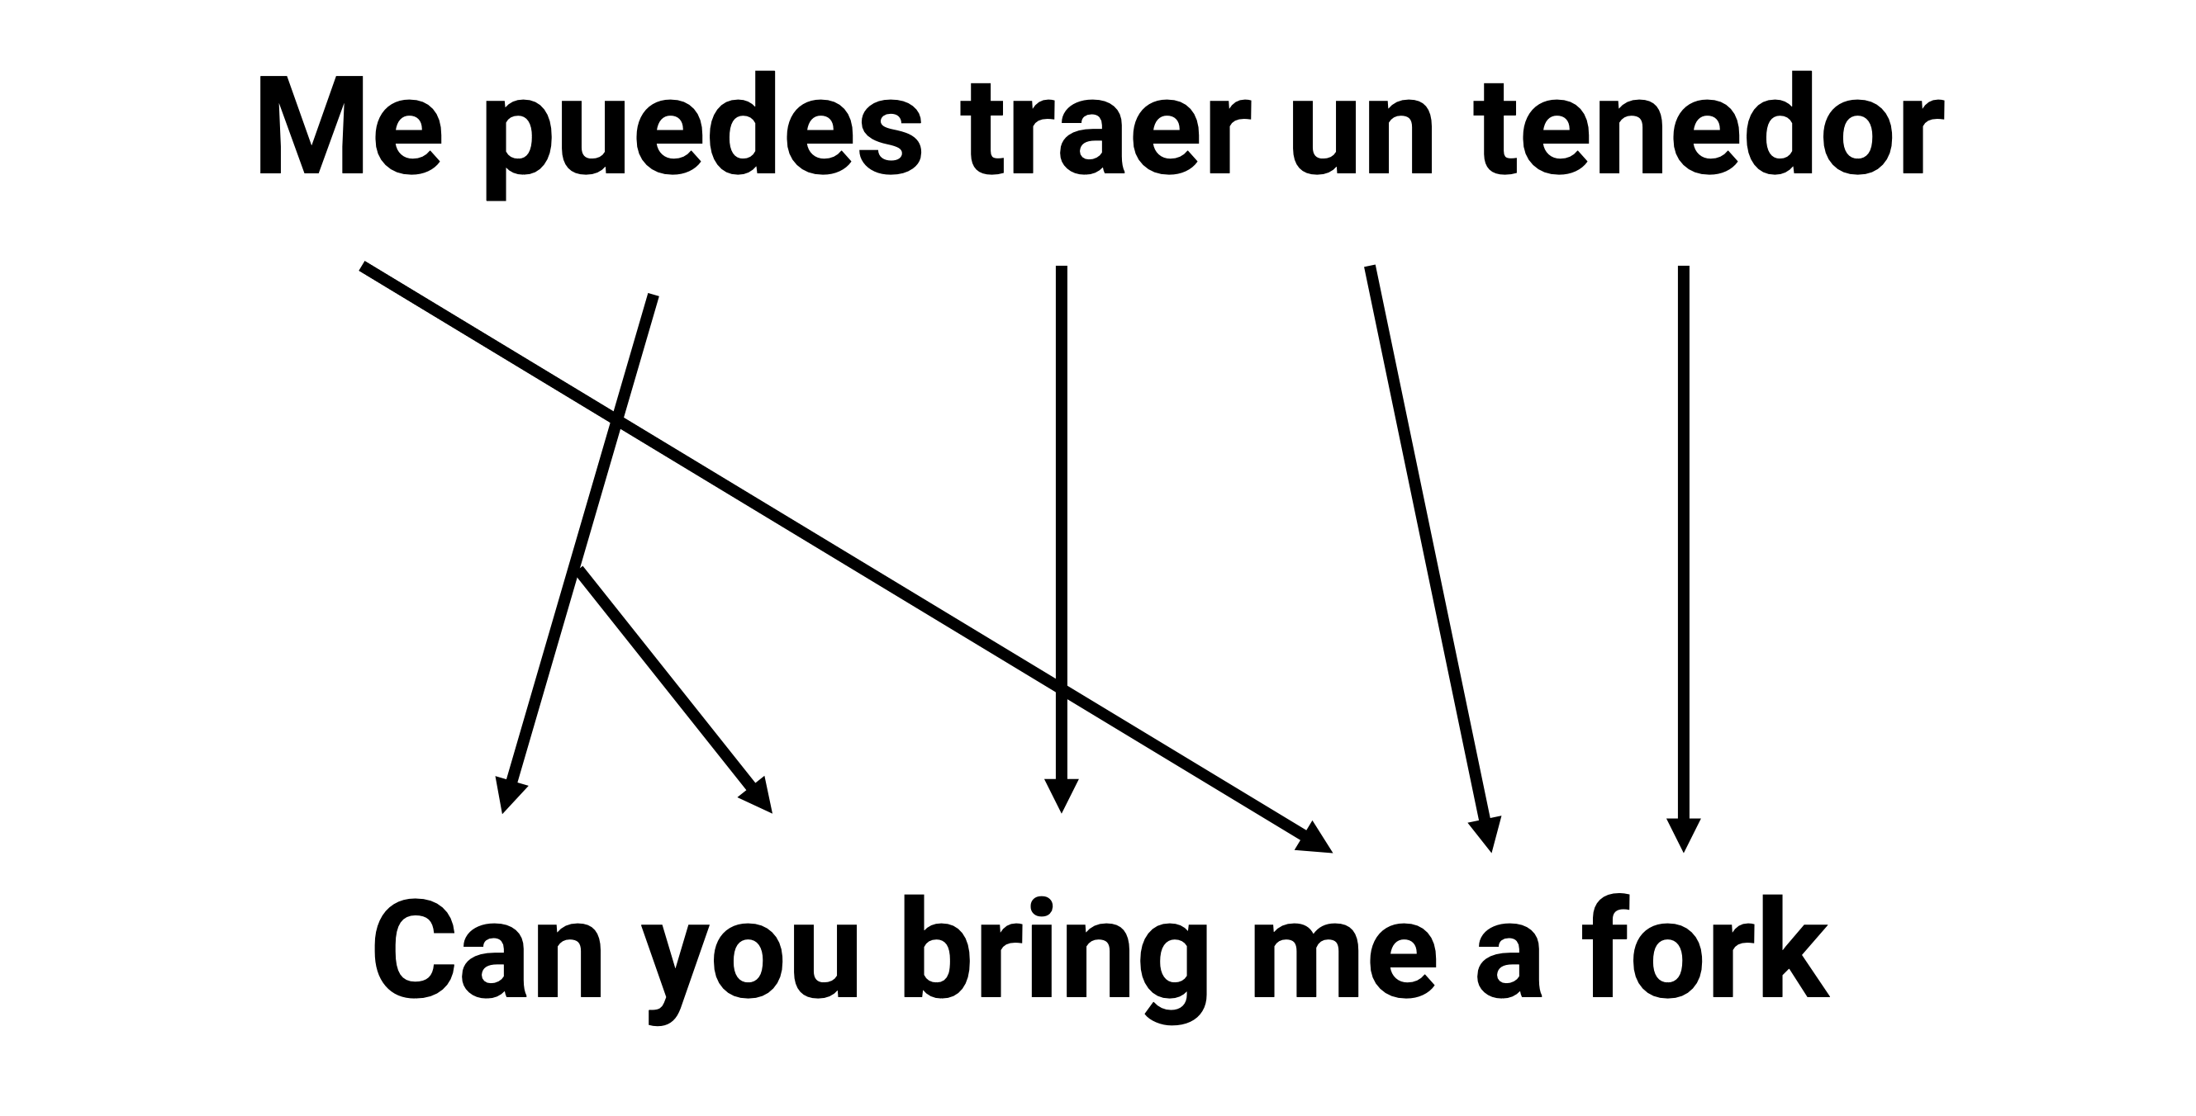
Struggling to Remember Long Sequences
Notes:
The challenge here in seq2seq models is to compress all of the input information into a single hidden state, to then enable output generation.

Slide 7
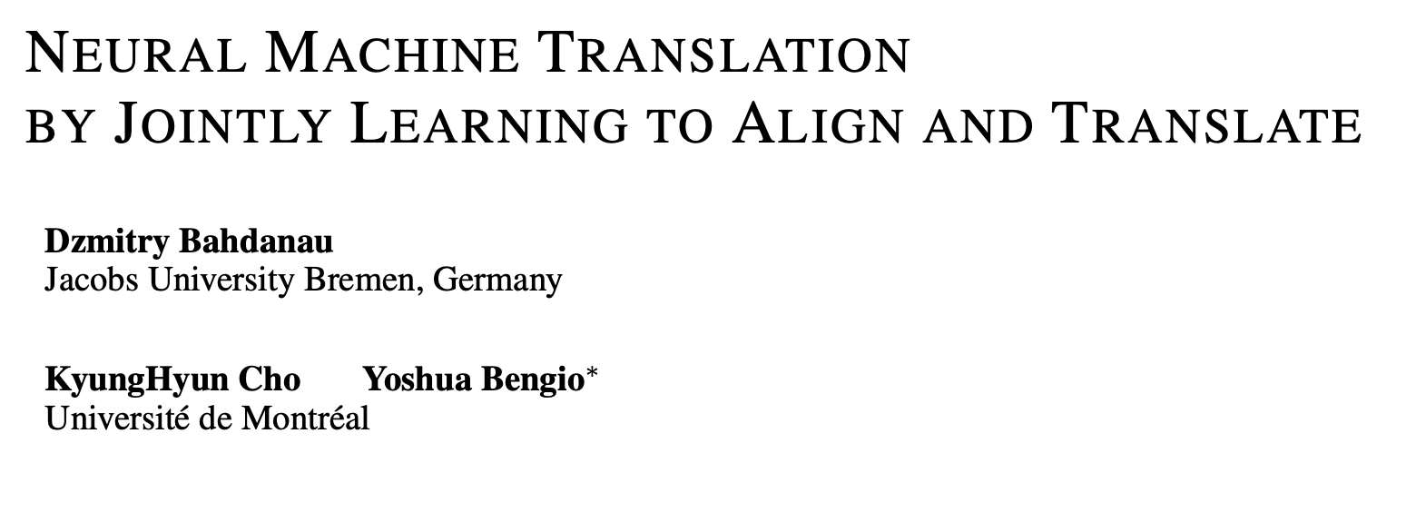
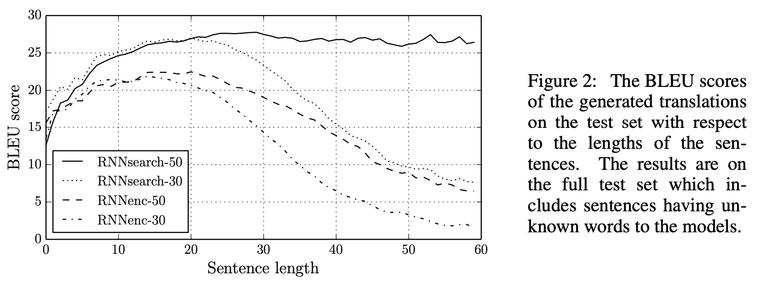
The First (RNN) Attention Model
“ … allowing a model to automatically (soft-)search for parts of a source sentence that are relevant to predicting a target word …”
Notes:
The challenge here in seq2seq models is to compress all of the input information into a single hidden state, to then enable output generation.

Slide 8
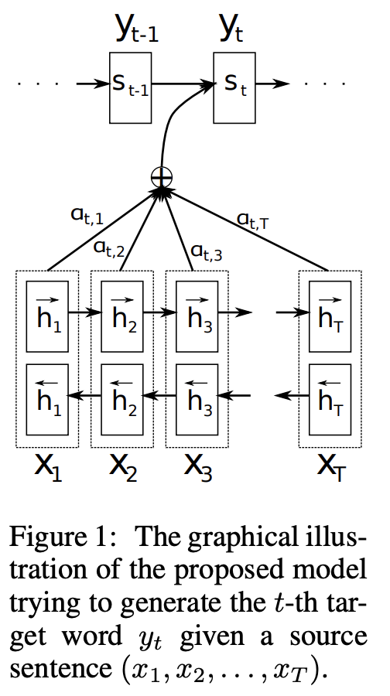
The First (RNN) Attention Model
Three RNNs
Bidirectional RNNs handle the input sentence (encoder).
A single RNN handles the output sequence (decoder).
Process
Bidirectional RNN reads sentences in both directions. Produces a pair of hidden state outputs for each token of input.
Unidirectional RNN reads output sentence forwards and produces a single hidden state, s.
Attention weights at a particular token position are calculated across all input tokens comparing s_t-1 with each pair of h_i hidden states. This yields a vector of attention weights. We softmax the attention weights to make them positive and add up to 1 (easier to differentiate in backprop).
Attention weights down- or up-weight each positional hidden state, h.
Finally, prediction, y_t, is based on the attention-reweighted hidden states of the input series and the last hidden state from token prediction y_t-1 (i.e., s_t-1).
Notes:
Novel idea.. we’ll have an RNN processing the input and yielding attention weights / context vector, which will be provided in tandem with memory from regular sequence processing by an RNN, to help the model gain access to all sequence information at the time it makes a prediction.

Slide 9
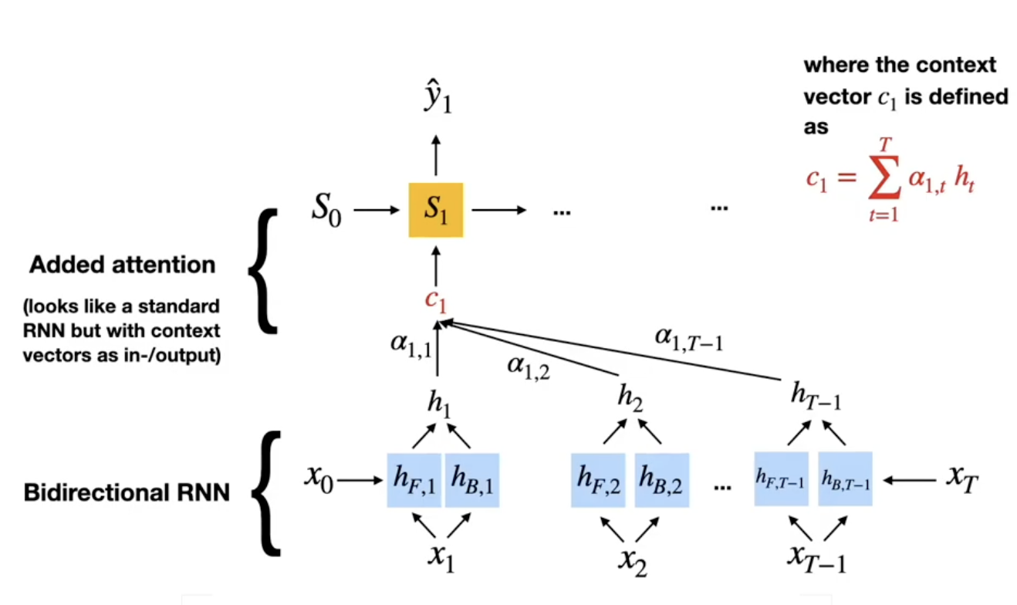
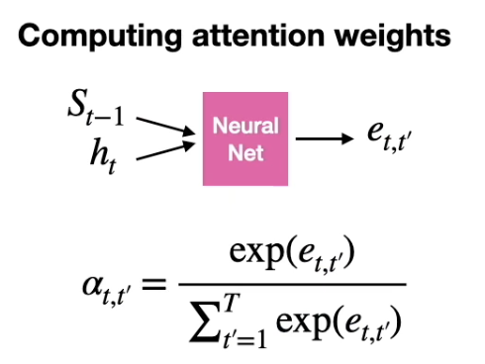
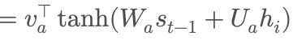
The First (RNN) Attention Model
Notes:
The hidden state from the forward moving RNN e.g., h_f1, is concatenated with the hidden state for that same token from the backward moving RNN, e.g., h_b1.

Slide 10
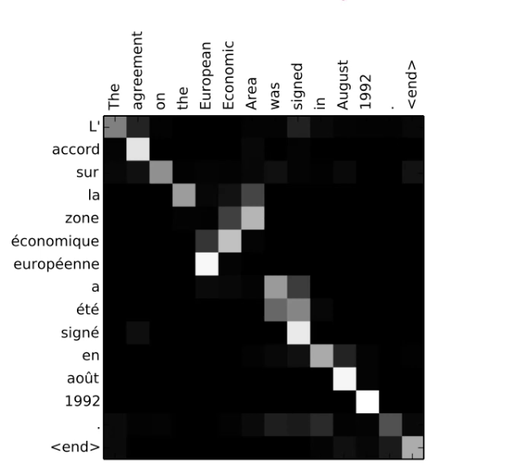
The First (RNN) Attention Model
Notes:
These are the attention scores that the model learns to assign to input tokens (words) across the entire input sequence when predicting a given output token (word) in the output sequence.
Strong diagonal alone means one-to-one translation of terms works okay, but in several cases we see that the the model pays attention to many other words when deciding how to translate a term… for example, when translating L’ it looks at both “The” and “signed” and “agreement.”

Slide 11
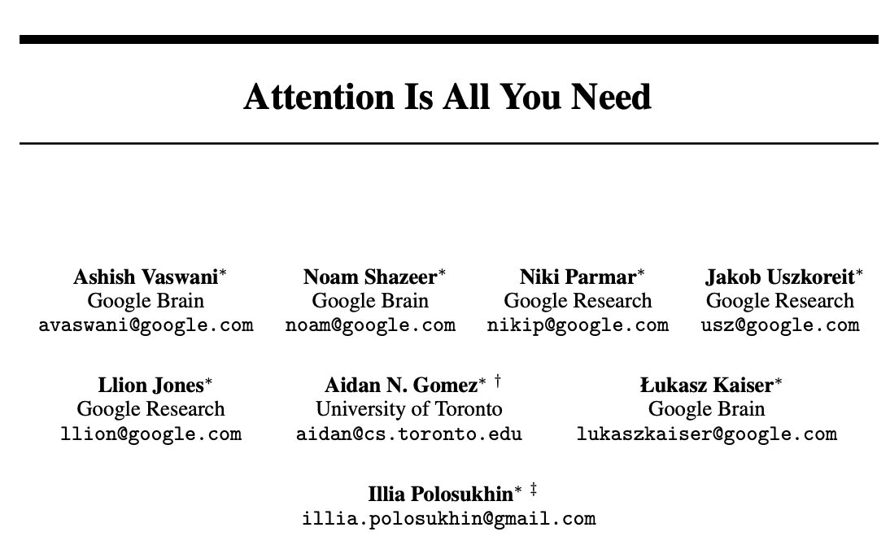
We Don’t Need an RNN
We Can Drop the RNN and Process the Whole Sequence in Parallel
Note that transformers work with a similar encoder architecture, but no LSTMs are needed (we use ”stacked attention layers”).
Transformers are more computationally expensive (more calculations required), but because we can parallelize them, they can be trained faster than RNNs.
By moving away from RNN specific implementation we can also think about more general forms of attention (e.g.,. For CNNs).

Slide 12
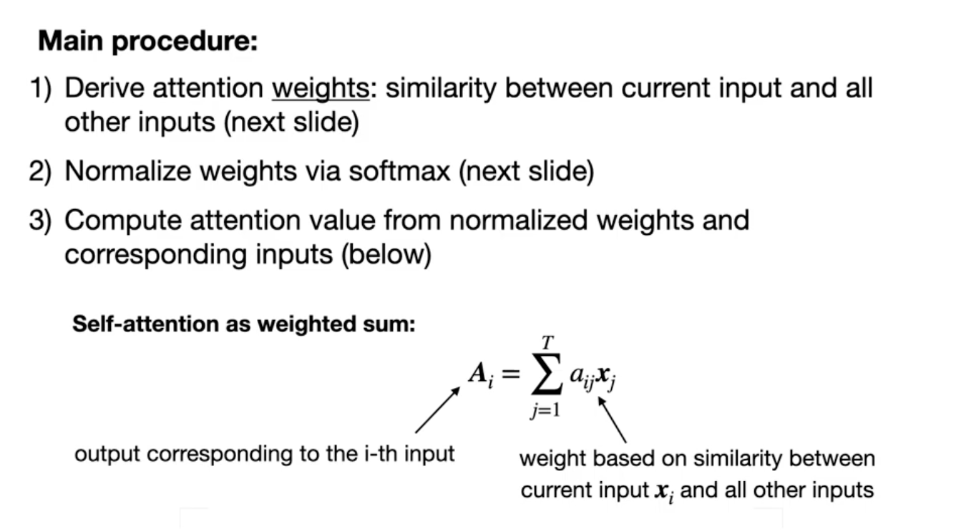
A Simpler (Less-Flexible) Attention Mechanism
Notes:
Here, A for word i is a weighted sum of all words in the sequence, indexed by j. The weights are based on how similar each other word in the sequence is to word i (e.g., based on dot-product). If we find that word I is very semantically similar to many other words in the sequence, we are going to give it a big A (it matters more). If word i is not related to all the other words, we give it a low A.

Slide 13
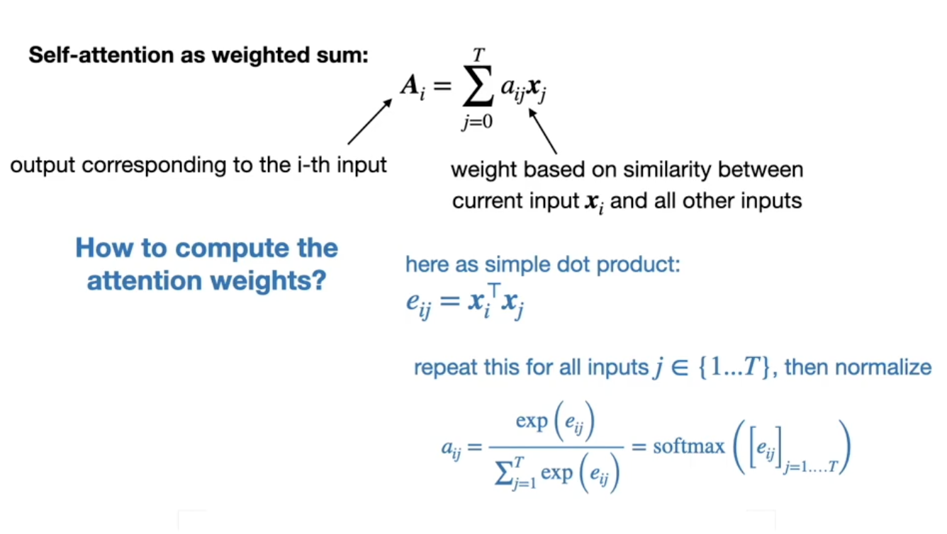
A Simpler (Less-Flexible) Attention Mechanism
Notes:
Here, A for word i is a weighted sum of all words in the sequence, indexed by j. The weights are based on how similar each other word in the sequence is to word i (e.g., based on dot-product). If we find that word I is very semantically similar to many other words in the sequence, we are going to give it a big A (it matters more). If word i is not related to all the other words, we give it a low A.
For word i, we take all pairs with other words, j, and calculate their dot products (e). We then softmax the resulting vector of dot product values. This forces the weights to sum to 1, and all lie between 0 and 1.
Once we have the a_ij reflecting word i’s association to each other word, we can now multiply the weights by each word in the sequence and add them up to get big A (roughly interpreted as the importance of word i, or how much attention we should pay to word i.

Slide 14
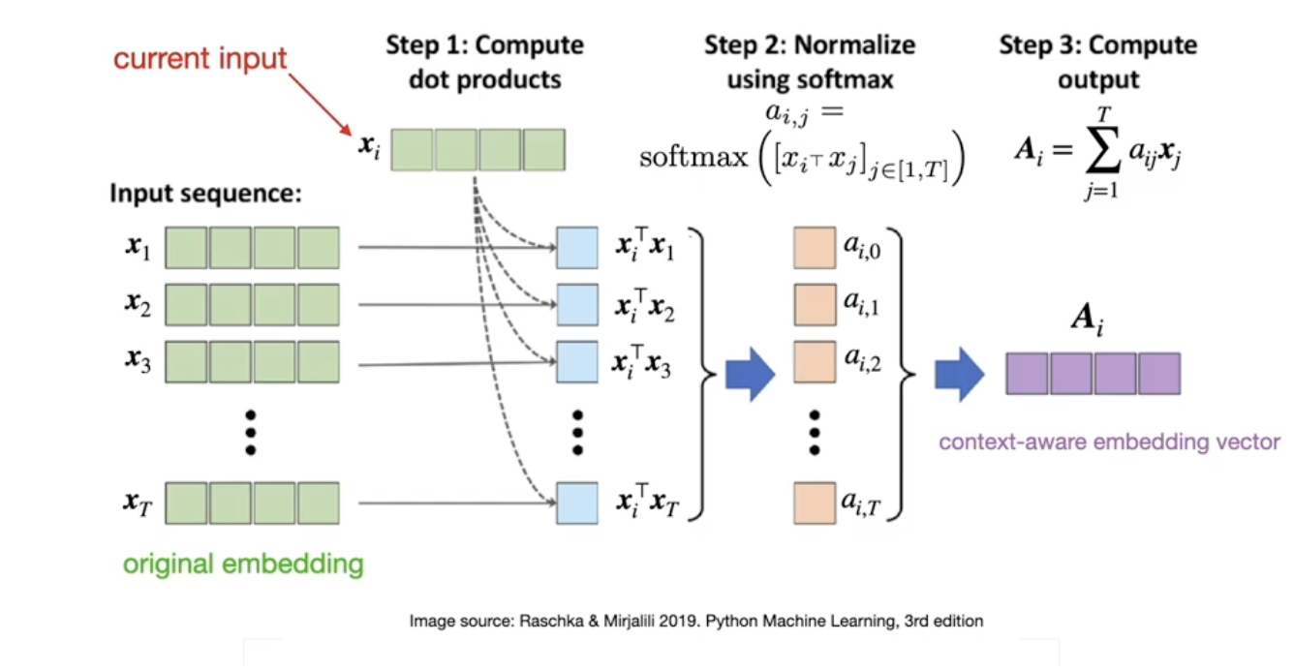
A Simpler (Less Flexible) Attention Mechanism
Notes:
Basically, what we end up with is a vector of A values (one for each input), which we use to predict outputs. You can think about this as replacing term x_i with a context-aware version of x_i. It’s like, forget about x_i, let’s think about an embedding which is a combination of all the words in the sequence (including term x_i) that collectively relate to the concept that word x_i captures. We are looking over the entire input set and adjusting each input token based on what is happening elsewhere in the input set that is relevant to the input token.
Some notes…
x_i is a vector (embedding).
x_i dot x_j is a scalar
a_i,j is the softmax of those various dot products, and each output is again a scalar.
A_i = sumprod(a_i,j and x_j) which is a vector because we sum over only one axis (if we have an 8D embedding to start, we sum over the 8 Ds, and get an 8D context-adjusted embedding.
for x_i we are left with one A_i (the adjusted version of x_i.

Slide 15
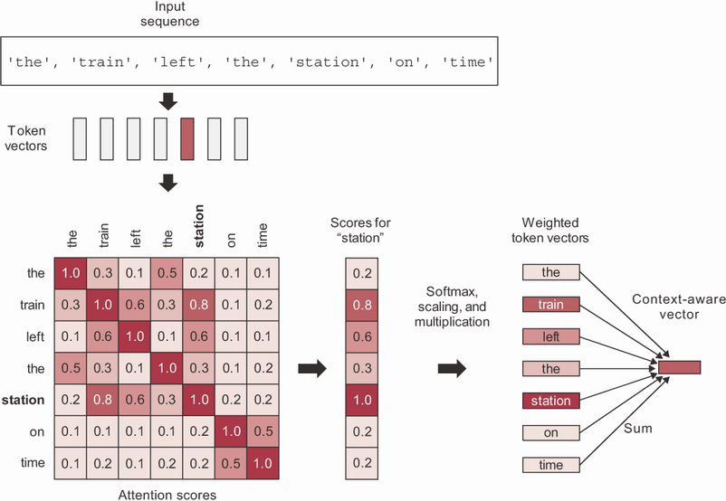
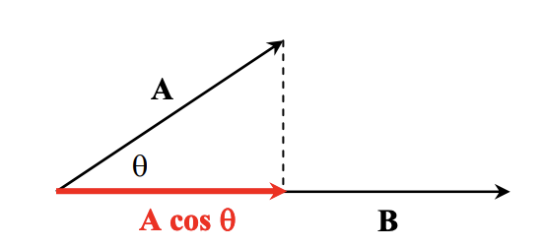
A Basic Self-Attention Mechanism
Most Basic Form of Self-Attention
This is what the textbook introduces.
We magnify vector representations of tokens based on how parallel (semantically related) they are to the other tokens in the input sequence.

Slide 16
This Basic Attention Mechanism is Rigid
The Approach Considers the Input Context in a Very ‘Fixed’ Manner
Although it doesn’t assume forward / backward sequence information is most important, it does assume a specific attention rule.
We get context-specific attention weights, but the notion of how context is processed is pre-defined / hard-coded in the dot-product-summation procedure; it’s not learned.
The pre-defined approach to attention does not generalize outside of language.
The pre-defined approach to attention assumes that shared semantic similarity is the best heuristic for attention, but perhaps it is not in some cases. Most obviously, perhaps in some scenarios it is ideal to focus attention on words that are semantically dissimilar.
How can we enable a procedure of this sort, but using trainable parameters, so the network can figure out how to allocate attention by itself?

Slide 17
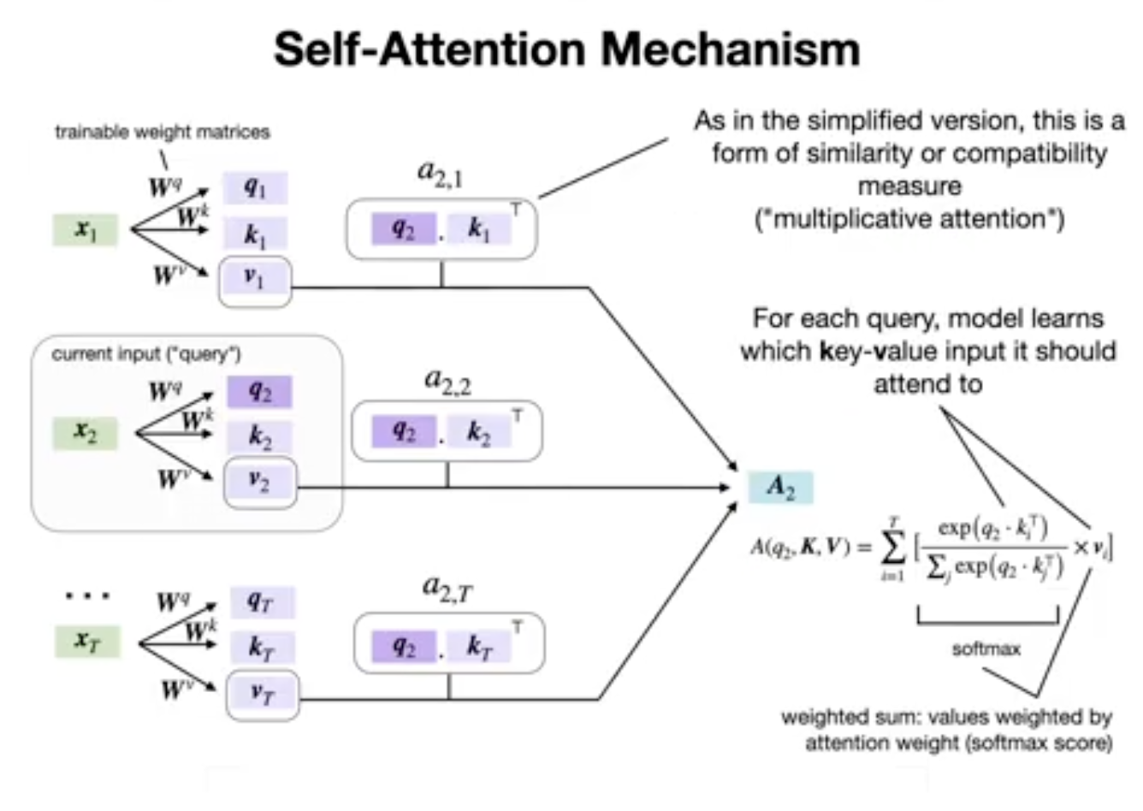
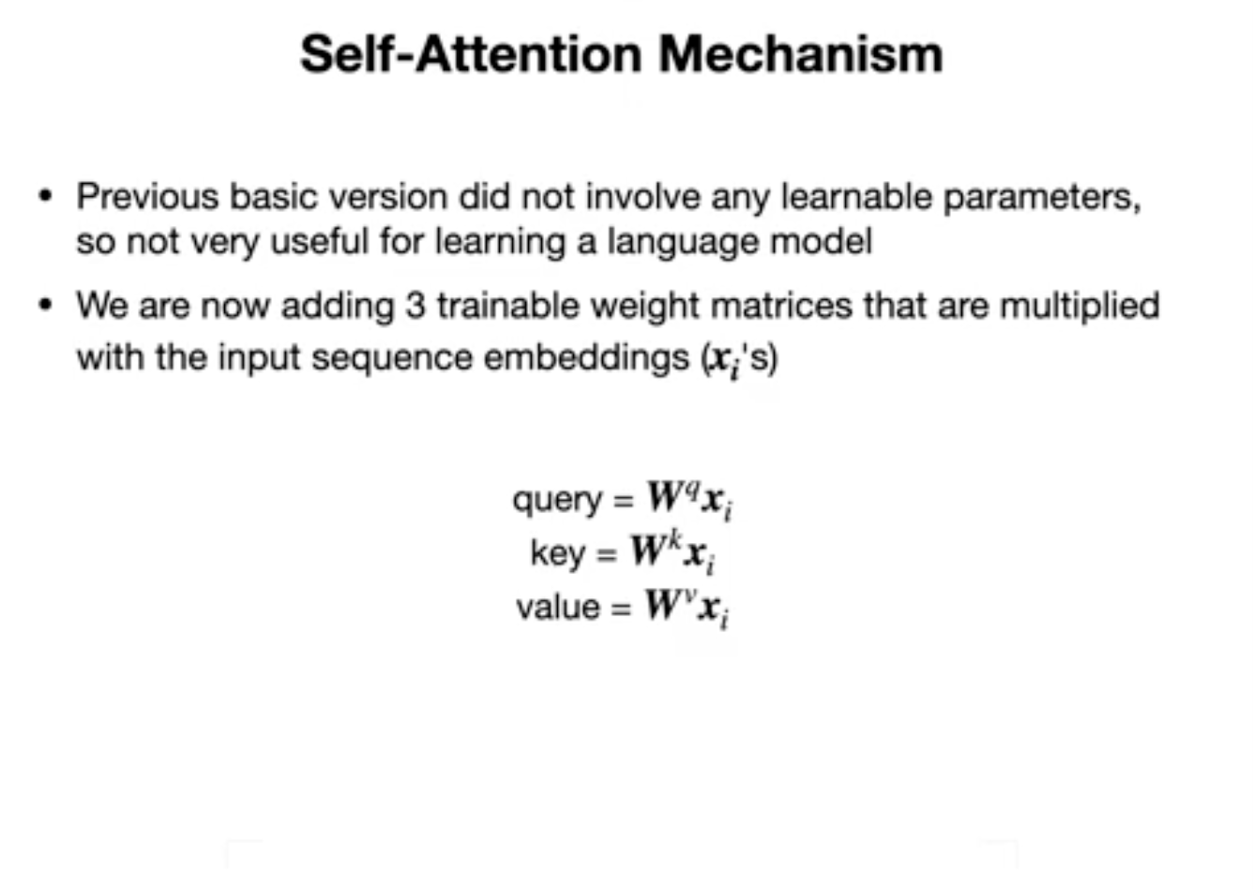
Query Key Value Framework
Notes:
Query, Key and Value comes from the idea of a database lookup.
Query, Key and Value are all weight-matrix multiplied versions of the original input sequence (of embeddings). Thus, rather than use the raw embedding and take its dot product with other raw embeddings, now we have trainable parameters that first apply possibly different transformations to the input embedding of the focal token, to the embeddings of the other tokens in the context, and we then incorporate the eventual attention-modified contextual embedding multiplicatively, with yet another weighted version of the original input embedding. The process is essentially the same as scaled dot-product, but now we have a whole bunch of trainable parameters that let us play with *what* we take the dot products of, and with how we integrate the the attention-weighted information into our prediction.

Slide 18
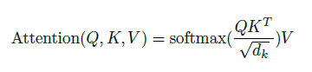
‘Scaled’ Dot Product
Scaled Dot-Product Attention…
One other nuance is that we scale the Softmax input.
This is done to prevent the dot products from getting too big, which can cause the output of softmax to tend toward 1 or 0 and lead to vanishing gradient issues.
sqrt(d_{k}) is the square root of the dimensionality of the input key embeddings (in the original paper, this was the same as the dimension of the word embeddings).
We write this in big-letter notation because we can parallelize everything as tensor calculations.
Notes:
Query, Key and Value comes from the idea of a database lookup.
Query, Key and Value are all weight-matrix multiplied versions of the original input sequence (of embeddings). Thus, rather than use the raw embedding and take its dot product with other raw embeddings, now we have trainable parameters that first apply possibly different transformations to the input embedding of the focal token, to the embeddings of the other tokens in the context, and we then incorporate the eventual attention-modified contextual embedding multiplicatively, with yet another weighted version of the original input embedding. The process is essentially the same as scaled dot-product, but now we have a whole bunch of trainable parameters that let us play with *what* we take the dot products of, and with how we integrate the the attention-weighted information into our prediction.

Slide 19
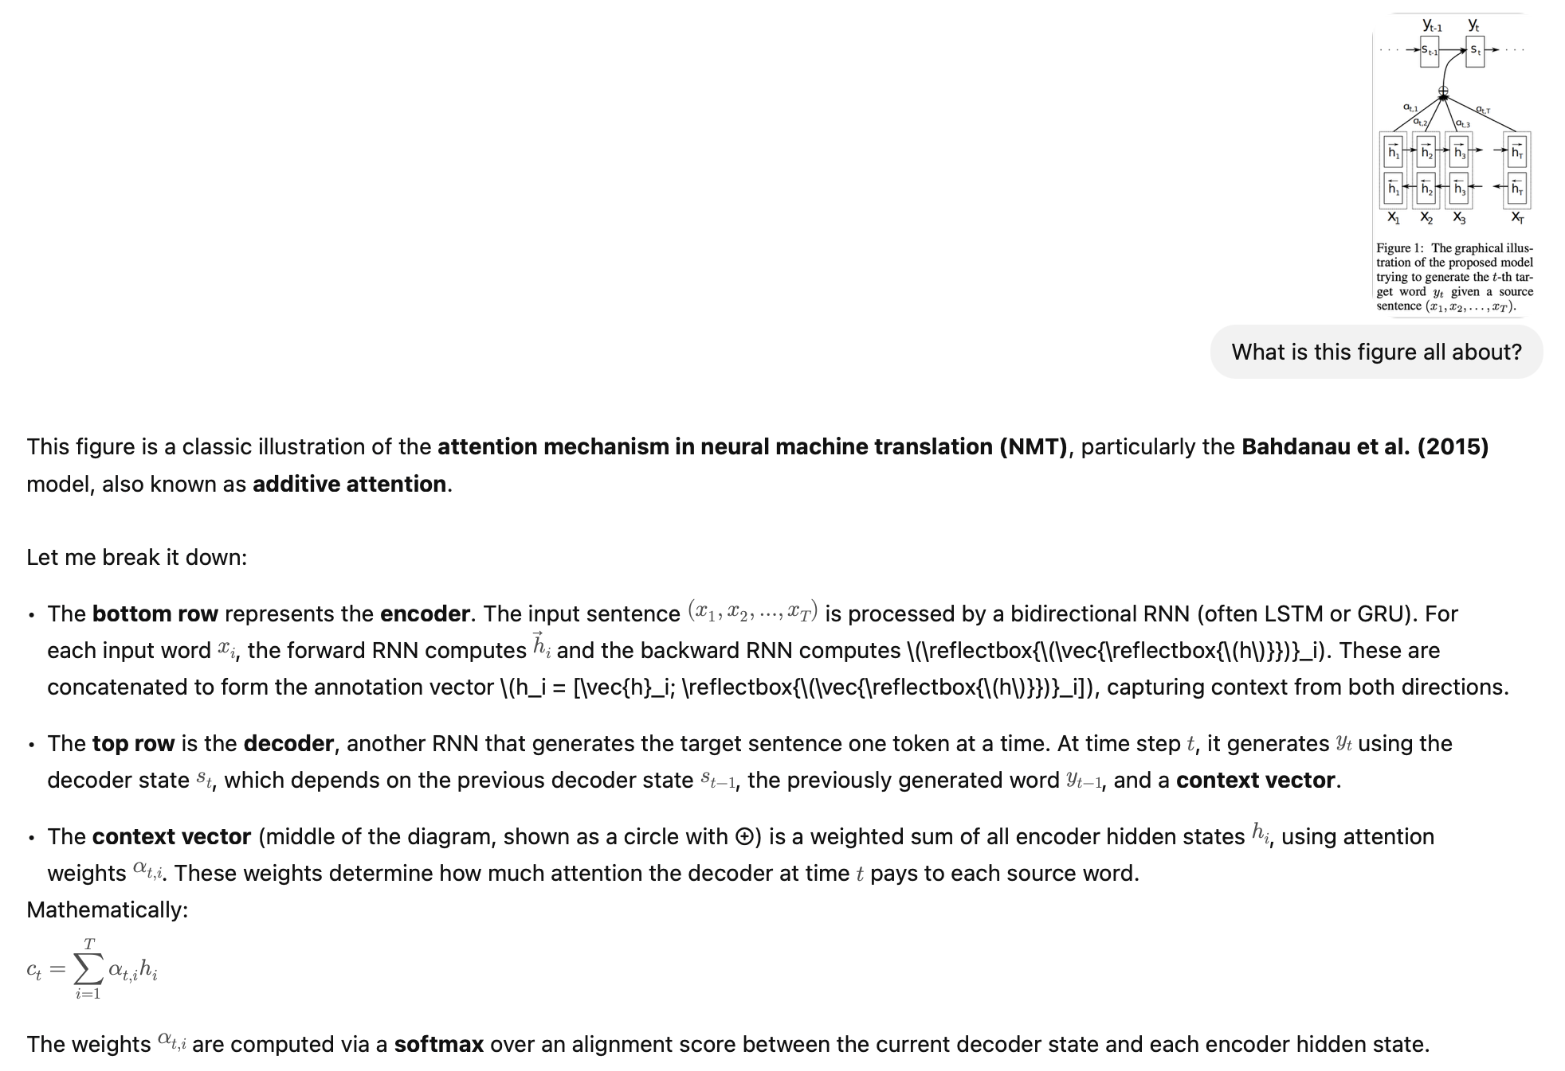
From Self-Attention to Cross-Attention
We now have the freedom to learn attention scores for input in one modality of input data to inform what we do with another modality of data.
Example: Image Q&A
You input an image (e.g., via a CNN or Vision Transformer), producing visual features.
Then input a text prompt (e.g., for captioning or VQA).
Use cross-attention: the text tokens query the image features to decide what visual content is relevant.

Slide 20
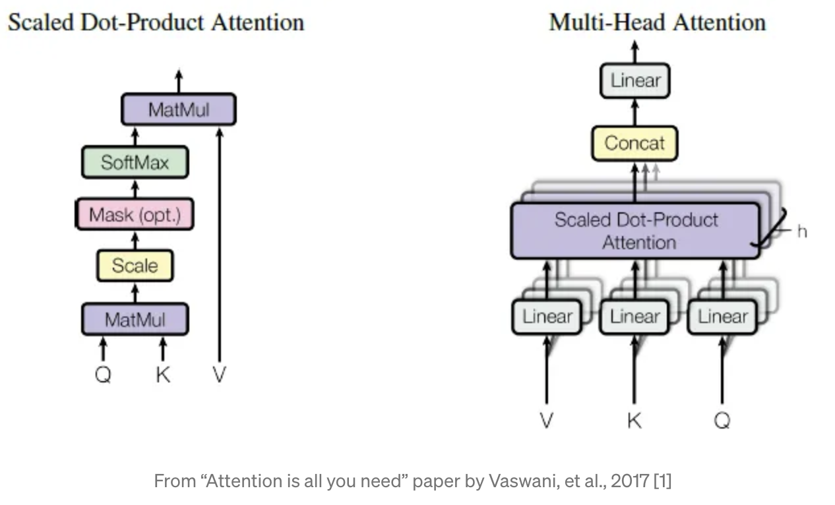
Multi-Head Attention
We have Multiple ‘Heads’ Paying Attention
Each head can be thinking about something very different.
By using multiple sets of query, key and value weight matrices, the network can learn to consider different combinations of input features.
This lets it capture more complex patterns in the data.

Slide 21
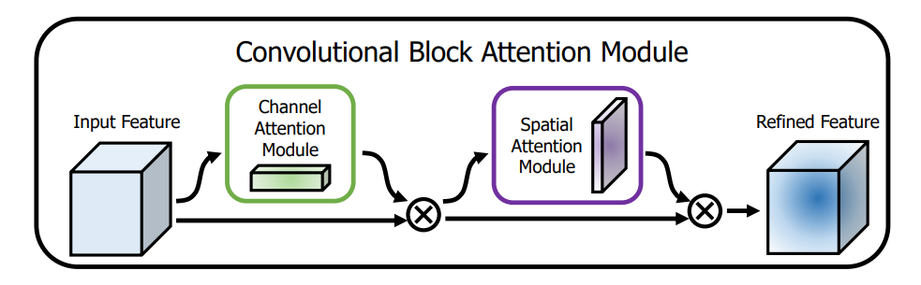
Attention in Vision Models
Spatial Attention
We chunk images spatially and implement an attention mechanism to allow a model to decide which portions of the image it should focus on.
Channel Attention
We implement an attention mechanism that allows the model to decide which feature maps are important for a prediction task.

Slide 22
Questions?
Notes:
Weights are not initialized until you “build” the model (or compile it, which will first build).

